Slide 1


Recommender Systems
Presenters:
Thodoris Liapikos
Vassilis Barzokas

Slide 2

Agenta
2
What is a Recommender System
01
04
Evaluating of Recommender Systems
Basic Principles
02
05
Popular Recommender Systems
Basic Types of Recommender Systems
03

Slide 3
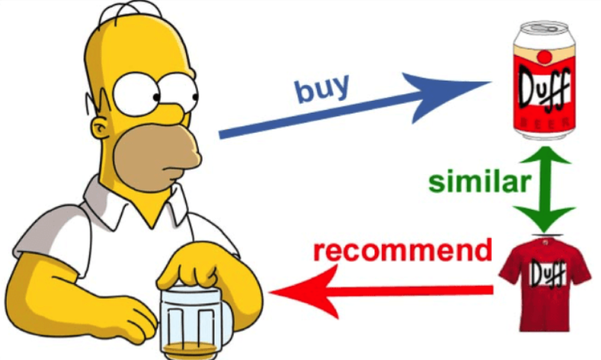
Introduction
3
What is a recommender system?
Utilize various sources of user feedback to infer customer interest
By recommending
carefully selected items to users, they bring relevant items to their attention
Primary goal is to increase revenue for the merchant
“Many receive advice, only the wise profit from it.”
Harper Lee

Slide 4
Basic principles
4
The basic principle of recommendations is that significant dependencies exist between user and item-centric activity
The entity to which the recommendation is provided is referred to as the user
The product being recommended is referred to as the item
Recommendation
analysis is based on previous interaction between users and items

Slide 5
Types
5
Basic types of recommender systems
Collaborative
Content based
Knowledge based

Slide 6
Collaborative
6
Use the collaborative power of the ratings provided by multiple users to make recommendations.
Sparse data
Inter-item correlations
Ratings are highly correlated between users and items
Inter-user correlations

Slide 7
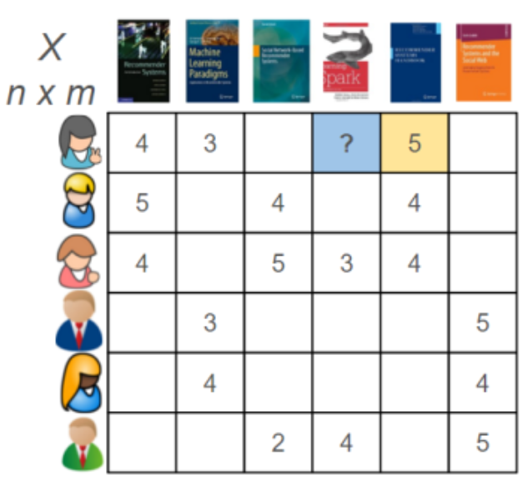
Feedback matrices
7
Data is organized in 2d feedback matrices
Each row represents a user
Each column represents an item
Each value represents the relation (visit, rating, buy) between user and item

Slide 8
Feedback matrices
8
Most used
Refers to ratings of user to items that are already known
Evaluated by:
5 point Likert scale
Binary ratings (like/dislike)
Evaluates user behavior
Extracts conclusions about user-item relationship
Explicit Feedback
Implicit Feedback

Slide 9
Collaborative
9
Methods of collaborative filtering
Memory based
Model based

Slide 10
Collaborative
10
Methods of collaborative filtering
Memory based
Model based
User based collaborative filtering
Item based collaborative filtering
Matrix factorization

Slide 11
Collaborative
11
Methods of collaborative filtering
Memory based
Model based
Graph algorithms
Domain-specific rules
Clustering
Bayes networks

Slide 12
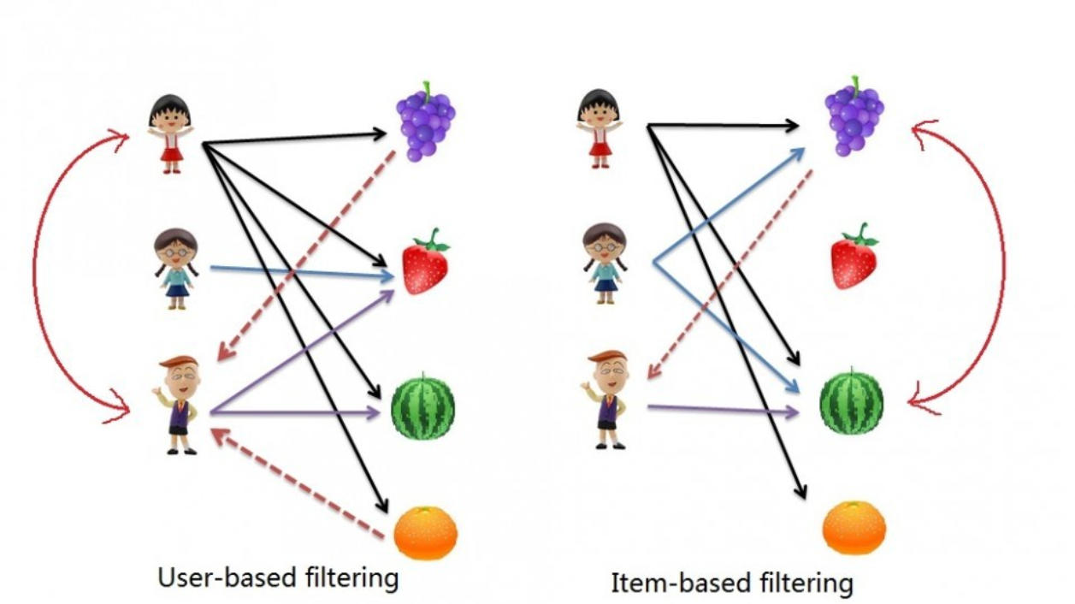
User & Item
12

Slide 13
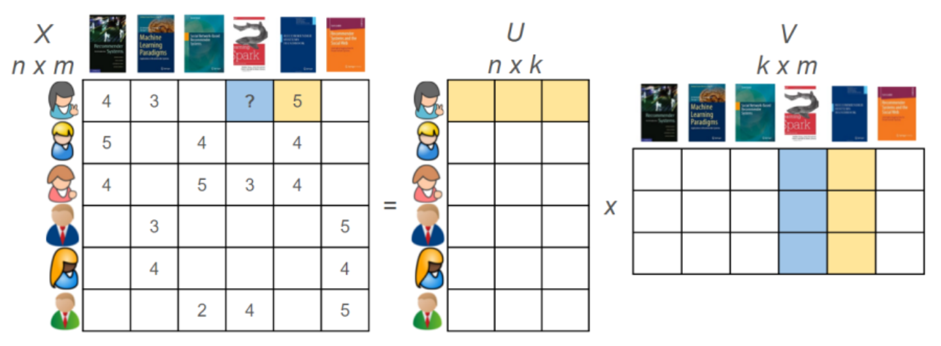
Matrix factorization
13

Slide 14
Content based
14
The descriptive attributes of items are used to make recommendations.
Content refers to descriptions
Effective for new items if ratings are not yet available
Ratings are combined with content information of the items
Not effective for new users

Slide 15
Knowledge based
15
The recommendation process is
performed on the basis of similarities between customer requirements and item descriptions.
Allows users to explicitly define what they want
Useful for items not purchased often
Knowledge bases contain data about rules and similarity functions
Useful for solving the “cold-start” problem

Slide 16
Evaluation
16
Accuracy
Metrics are similar to those used in regression modeling
Coverage
Fraction of users for which at least k ratings may be predicted
Novelty
Evaluates the likelihood of a recommender system to
give recommendations to the user that they are not aware of
Scalability
Training time
Prediction time
Memory requirements

Slide 17

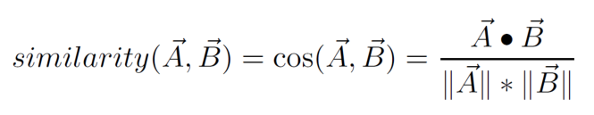
Popular systems
17
MovieLens Uses collaborative filtering to provide you with movie recommendations based on your personal references.
StumbleUpon Using ratings gathered with a collaborative opinion rating system it can match users with interesting websites based on their preferences.
Uses item to item collaborative filtering
Pandora
A comprehensive analysis of music in which a team of musician-analysts listen to and study each song and note nearly 400 attributes of each.

Slide 18


18
THANK YOU!

Slide 19
References
19
Aggarwal, Charu (2016). Recommender System The Textbook. Springer
Athulya, Remya (2016), A Case Study on Various Recommendation Systems, International Journal of Computer Application
Smith, Linden, Two Decades of Recommender Systems at Amazon.com, IEEE Internet Computing
Wikipedia (visit January 2019), https://en.wikipedia.org/wiki/Recommender_system
Wikipedia (visit January 2019), https://en.wikipedia.org/wiki/Matrix_factorization_(recommender_systems)

